Slide 1
Intermediate Algebra
Clark/Anfinson

Slide 2
Chapter Three
Powers/polynomials

Slide 3
Chapter 3 Section 1

Slide 4
Powers and roots
x + x + x + …. Repeated addition - product
x ∙ x ∙ x ∙ x ∙ … Repeated multiplication - power
base ^{exponent} = power
ALL numbers are products
ALL numbers are powers
Exponents do NOT commute, associate, or distribute

Slide 5
Laws of exponents
BASED on associative and commutative properties
IF the Bases of two powers match then:
xª ∙ x^{b} = x ^{a+b}
(xª)^{b} = x^{ab}
${x^{−a}=\left(\frac{1}{x}\right)}^{a}$ thus $\frac{x^{a}}{x^{b}}=x^{a−b}$
and $x^{0}=1$

Slide 6
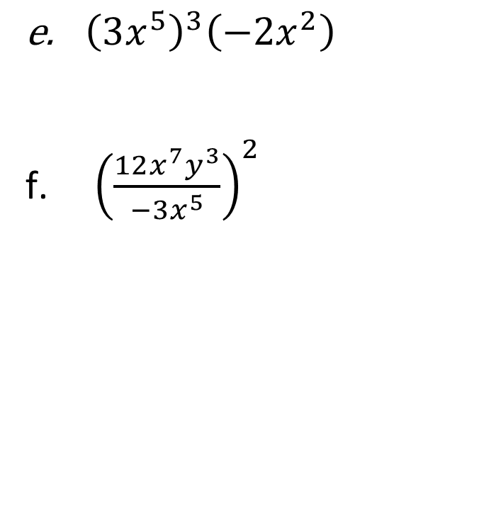

Examples- whole number exponents
a. $\left(3x^{4}y\right)\left(−2x^{3}y^{2}\right)$
b.${\left({−2xy}^{3}\right)}^{4}$
c. ${\left({−2x}^{4}\right)}^{5}$
d. $\frac{{10x}^{5}y^{3}}{2x^{2}y^{3}}$
${\left(3x^{5}\right)}^{3}\left({−2x}^{2}\right)$
${\left(\frac{12x^{7}y^{3}}{−3x^{5}}\right)}^{2}$

Slide 7


Examples: integers exponents
${\left(\frac{3}{5}\right)}^{−2}$
$5x^{−3}$
${\left({−2x}^{2}\right)}^{−3}$
$\frac{10x^{−2}y^{5}}{15xy^{−4}}$
${\left(\frac{5x^{−3}y^{−2}}{15x^{−5}}\right)}^{−4}$

Slide 8
Roots as exponents
The inverse of multiplication is division – in power notation this is the negative exponent
The inverse of power is root –
$\sqrt[index(exponents)]{power}=base$
In power notation this is a fractional exponent
note: $\sqrt{5^{2}}=5$ similarly $\sqrt[3]{4^{3}}=4$
it is reasonable to write ${\left(5^{2}\right)}^{1/2}=5$
and ${\left(4^{3}\right)}^{1/3}=4$

Slide 9

Exponent notation for roots
Therefore $\sqrt[a]{x} = x^{1/a}$
It follows that $\sqrt[a]{x^{b}}= x^{b/a}$

Slide 10
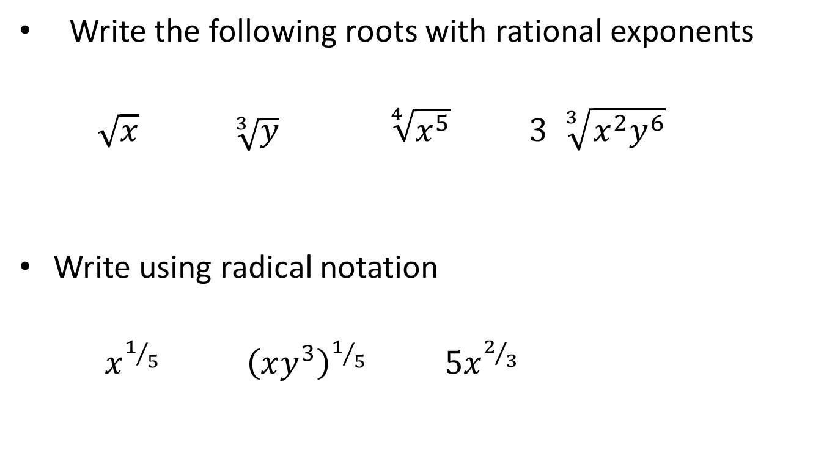
Examples
Write the following roots with rational exponents
$\sqrt{x}$ $\sqrt[3]{y}$ $\sqrt[4]{x^{5}}$ $3 \sqrt[3]{x^{2}y^{6}}$
Write using radical notation
$x^{1/5}$ ${\left(xy^{3}\right)}^{1/5}$ $5x^{2/3}$

Slide 11

All rules of exponents apply to rational exponents
Examples:
$\left(x^{2/3}\right){\left(x^{1/5}\right)}^{{10}/3}$

Slide 12
Chapter 3 section 2
Polynomial operations (combining functions)

Slide 13
Polynomial: sum of whole number powers
means – NO negative exponents No rational exponents
5x⁷ – 3x⁴ + 2x² – 8x + 7 is a polynomial
3x⁻¹ + 2x³ is not a polynomial
$5x^{2/3}+3$ is not a polynomial
Note – linear problems ARE polynomials

Slide 14
Vocabulary
term - a number that is added to other numbers
Coefficient – the numeric factors of a term
Degree of a term – the number of variable factors in the term
Degree of a polynomial – the degree of the highest degreed term
Constant term – a term with no variables
Variable term – a term that has variables
Descending order – writing the terms in order of degree

Slide 15
Example
5x + 6 - 7x³ - 12x²
How many terms does the polynomial have?
what is the coefficient of the 2nd degree term?
Is this in descending order?
What is the degree of the polynomial?

Slide 16
Adding/subtracting polynomials
Addition – ignores the parenthesis and combines like terms - Note: like terms match powers exactly – exponents do NOT change
Subtraction – distributes the negative sign (takes the opposite of all terms inside the parenthesis) then combines like terms
These are not equations – do not insert additional terms

Slide 17
Examples - addition
(5x² -2x + 3) + (4x² + 7x +8)
(3x⁵ + 2x² -12) + (3x³ – 7x² -10)
(2x⁵ +3x² ) + (x⁵ -12x²)

Slide 18
Examples: Subtraction
(5x² + 3x – 9) - (2x² – 6x -15)
(3x⁵ + 7x³ + 5) - (12 – 3x³)
(2c³ – 4c² + 3c) - (6c² + 3c – 9)

Slide 19
Multiplication of polynomials
Always involves distribution –
Exponents change when you multiply

Slide 20
Examples
3x²(5x – 7y)
-x³y⁴(7x² + 3xy – 4y⁵)
(x – 9)(x + 5)
(2x – 7)(3x² – 2x + 2)
(x² – 5x + 1)(x² +2x– 4)
5x³(2x – 9)(3x + 2)

Slide 21
Powers
Exponents do not distribute
Multiplication DOES distribute
Powers are repeated multiplication

Slide 22
Examples:
(x + 7)²
(3x – 4)²
(2x + 5y)²
(x – 7)³

Slide 23
FOLLOW order of operations
Examples
3(2x² – 5) – 3x(2x – 7)
(x + 2)(x – 5)² – 3x(x – 5)

Slide 24
Chapter 3 – section 4
factoring

Slide 25
Factoring is a division process
Type one - monomial factoring
Determines that a single term has been distributed to every term in the polynomial and “undistributes” that term
Type two – binomial factoring
Determines that distribution of multiple terms has occurred and “unfoils” the distribution

Slide 26
Monomial factoring : ex. 12c – 15cd
Find the term that was distributed – it will be “visible” in all terms of the polynomial – you must find everything that was distributed – ie the GCF
3 is a factor of 12 and 15- it was distributed
c is in both terms – it was distributed
Write them both OUTSIDE a single set of parenthesis
3c( )
Divide it out of the terms of the polynomial (divide coefficients and subtract exponents)
12c/3c = 4 -15cd/3c = -5d
Write the answers to the division INSIDE the parenthesis 3c(4 – 5d)

Slide 27
Examples:
5x + 10
2x² – 3x
27xy + 9y
7x³ + 21x²
6m⁴ – 9m⁶ + 15m⁸

Slide 28
Binomial factoring from 4 terms (factoring by parts) ex: 6xy – 2bx +3by- b²
When the polynomial has no GCF the factors may be binomials (2 term polynomials)
To factor into binomials from 4 terms –
1.Split the problem into two sections 6xy – 2bx and 3by – b²
2. find the common factor for the first 2 terms 2x
factor it out 2x(3y – b)
3. find the common factor for the last 2 terms b
factor it out b(3y – b)
4. inside parenthesis should be the same binomial ; If it’s not then the polynomial is prime
5. Write the 2 outside terms together and the 2 inside terms
together Arrange them:
(outside1 + outside2)(inside 1 + inside 2)
(2x + b)(3y – b)
If you have done it correctly you can check your answer by multiplying it back – you should get back to the problem

Slide 29
Examples:
x³ + 5x² + 3x + 15
ab - 8a + 3b – 24
6m³ -21m² + 10m – 35
mn + 3m +2n + 6

Slide 30
Binomial Factors from trinomials(3 terms)
Consider the multiplication problem
( x + 7)(x + 5)
These are the factors of the polynomial
x² + 12x + 35
Notice that the 35 is the product of 7 and 5
and 12 is the sum of 7 and 5
Because of the distribution this pattern will often occur

Slide 31
Examples
x² + 5x + 4
m² - 15m + 36
w² – 7w – 30
r² + 5r - 14
m⁴ + 7m² + 12
g² + 7gh – 18h²

Slide 32
Binomial factoring ax²
Consider (3x + 4)(2x +7)
6x² + 21x + 8x + 28
6x² + 29x + 28
Note: that while (4)(7)=28; 4 + 7 is not 29
– this is because of the 3 and the 2 that multiply also
There is a number on the x² term – this is a clue that the factoring is more complicated but fundamentally the same.

Slide 33
Examples:
2x² + 13x + 20
6x² + 23x + 21
8x² – 14x – 15

Slide 34
Examples of binomial with monomial factoring
2x² – 6x + 4
5x³ + 25x² – 30x
3x³ – 2x² + x

Slide 35
Chapter 3 – section 5
Special factoring patterns and factoring completely

Slide 36
Factoring patterns
a² – b² difference of squares
= (a + b)(a – b)
a³ + b³ sum/difference of cubes
= (a + b)(a² - ab + b²)
a² + 2ab + b² Square trinomial
(a + b)²

Slide 37
Examples – square trinomials
x² + 6x + 9
x² – 10x + 25
9x² – 30xy + 25y²
10x² – 40 x + 4
16x² - 15x + 9
4x² + 20x - 25

Slide 38
Examples – difference of squares
x² – 9
x² -64
x² + 16
x³ – 16
x² – 14
(x+ 3)²- 36

Slide 39
Example – sum/difference of cubes
x³ – 27
y³ + 8
x³ – 216y³
x³ + 125y³

Slide 40
Factoring completely
ALWAYS check for common factors FIRST
Then check for patterns –
4 terms – factor by grouping
3 terms - binomial – check for square trinomials
2 terms – difference of squares or sum/dif of cubes
Finally check each factor to see if it’s prime

Slide 41
Examples
3x³ – 24x² +21x
x³ + 5x² – 9x - 45

Slide 42
Examples
5x³ – 20 x
x⁴ – 81
x³ + 4x² – 16x – 64
4x⁴ + 4x² – 8

Slide 43
examples
8x⁹ – 343

